Slide 1


FEATURE EXTRACTION AND PRICE PREDICTION
FOR MOBILE PHONES
Deewankar Sharma

Slide 2


Context
1
Project Overview
Problem Statement
Data Exploration
Data Preprocessing
Feature Extraction
Model Building
Model Evaluation
Feature importance analysis
Visualisation and Reporting
2
3
4
5
6
7
8
9
10

Slide 3

Project Overview
1
This project aims to enhance the pricing strategy of a mobile phone-selling organization by building a predictive model to estimate mobile phone prices based on various influential features. By performing comprehensive data exploration, preprocessing, feature extraction, and model building, we will identify key factors affecting mobile prices and provide actionable insights to inform business decisions.
2
3
4
5
6
7
8
9
10

Slide 4

Problem Statement
The organization seeks to better understand the dynamics of mobile phone pricing in a competitive market. Given a dataset containing detailed attributes of mobile phones—including specifications such as model, color, memory, RAM, battery capacity, camera specifications, and more—the goal is to develop an accurate predictive model that estimates mobile phone prices. This model will not only facilitate informed pricing strategies but also help the organization optimize its product offerings based on key features that drive consumer purchasing decisions.
1
2
3
4
5
6
7
8
9
10

Slide 5

Data Exploration
Importing Libraries and Dataset
Libraries Used: Libraries such as pandas, numpy, seaborn, matplotlib.pyplot, sklearn, dataprep were imported for data manipulation, visualization, modeling, and exploratory data analysis.
Dataset Overview: The dataset mob was imported from an Excel file (Processed_Flipdata.xlsx). It contains information about mobile phones, including features like model, color, camera specifications, processor, etc.
1
2
3
4
5
6
7
8
9
10

Slide 6
Data Exploration
Summary Statistics
Basic Statistics:
Mean, median, quartiles, and other descriptive statistics were computed for numerical variables using describe() method.
This provided insights into the central tendency and spread of numerical features such as price (Prize).
1
2
3
4
5
6
Data Types and Missing Values
Data Types: The dataset includes both numerical and categorical data types. Numerical columns include float and integer types, while categorical columns are represented as objects (strings).
Handling Missing Values: Missing values in numerical columns were imputed using the mean value (SimpleImputer from sklearn.impute). This ensures that all numerical features have complete data for modeling.
7
8
9
10

Slide 7
Data Preprocessing
1
Handling Missing Values
Process: SimpleImputer from sklearn.impute was used to fill missing values in numerical columns with their mean values (strategy='mean').
2
3
4
5
Dropping Unnecessary Columns
Rationale: The column Unnamed: 0 was dropped as it likely represents an index or identifier column that does not provide meaningful information for modeling.
6
7
8
9
10

Slide 8
Data Preprocessing
1
Log Transformation of Price (Prize)
Justification:
The Prize (price) column was log-transformed (np.log1p()) to normalize its distribution. This transformation helps the model better capture patterns in price variability, especially when prices span a wide range.
Outlier Detection and Treatment (IQR and Z-score)
Methods Used:
Outliers in the Prize column were detected using statistical methods such as Interquartile Range (IQR) and Z-score.
Detected outliers were subsequently treated to enhance model performance and ensure data integrity.
2
3
4
5
6
7
8
9
10

Slide 9
Feature Extraction
1
One-Hot Encoding for Categorical Variables
Reasoning:
Categorical variables such as Model, Colour, Rear Camera, Front Camera, and Processor were encoded using one-hot encoding (pd.get_dummies()).
This transformation converts categorical variables into a numerical format suitable for machine learning models like Random Forest Regressor.
Feature Importance Analysis
Importance:
Features were analyzed for their influence on predicting mobile prices using correlation analysis and model performance metrics.
Key features identified through this process include RAM, Memory, and specific camera attributes (Rear Camera, Front Camera).
2
3
4
5
6
7
8
9
10

Slide 10
Model Building
1
Selected Model: Random Forest Regressor
Choice:
The Random Forest Regressor was selected due to its ability to handle complex relationships in data, robustness to outliers, and ease of interpretation.
It is well-suited for predicting mobile prices based on diverse feature sets.
Model Training Process
Steps:
The model was trained using the training dataset, emphasizing parameter tuning (RandomForestRegressor from sklearn.ensemble).
Cross-validation techniques were applied to validate the model's performance and ensure its generalizability across different subsets of data.
2
3
4
5
6
7
8
9
10

Slide 11
Model Evaluation
1
Metrics Used: MAE, RMSE, R-squared
Evaluation Metrics:
Mean Absolute Error (MAE), Root Mean Squared Error (RMSE), and R-squared (R²) were used to assess the model's accuracy and goodness of fit.
These metrics quantify how well the model predicts mobile prices compared to actual values.
Actual vs. Predicted Price Scatter Plot
Visualization:
A scatter plot was used to compare actual mobile prices against predicted prices visually.
It demonstrates how closely the model's predictions align with actual prices and identifies areas where the model may need further refinement.
2
3
4
5
6
7
8
9
10

Slide 12
Feature importance analysis
1
Top Features Influencing Mobile Prices
Key Features:
Features such as RAM, Memory, and specific camera attributes (Rear Camera, Front Camera) were identified as most influential in determining mobile prices.
These insights were derived from feature importance scores obtained from the model (feature_importances_ attribute).
Visualization of Feature Importance
Visual Representation:
A bar chart or similar visual was used to present feature importance scores, highlighting the relative importance of each feature in predicting mobile prices.
This visual aids in understanding which features drive price variability in the mobile phone market.
2
3
4
5
6
7
8
9
10

Slide 13
Visualisation and Reporting
1
Exploratory Data Analysis (EDA)
Visual Tools:
Histograms, scatter plots, and violin plots were used during EDA to visualize distributions, relationships, and correlations between features and mobile prices.
These visuals provide insights into data patterns and relationships that inform subsequent modeling and analysis.
Insights Gained from EDA
Key Findings:
Insights such as the impact of RAM and camera quality on price variability were summarized from EDA.
These findings help stakeholders understand consumer preferences and market dynamics in the mobile phone industry.
2
3
4
5
6
7
8
9
10

Slide 14
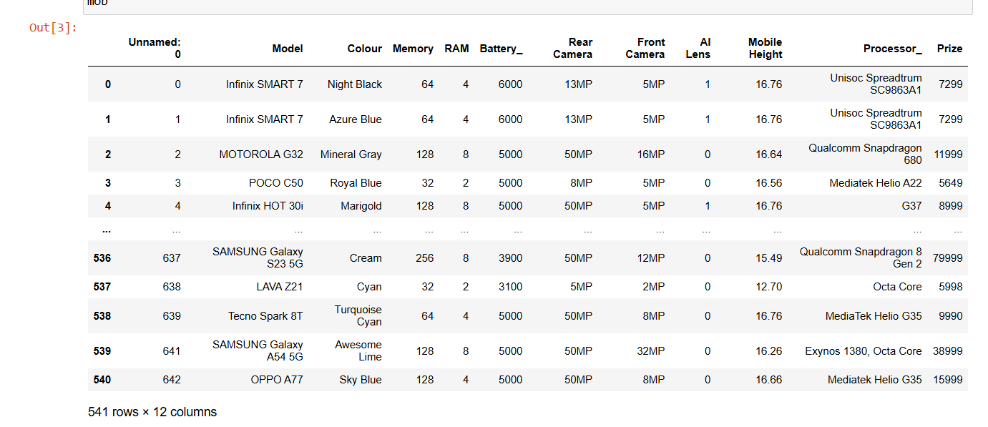
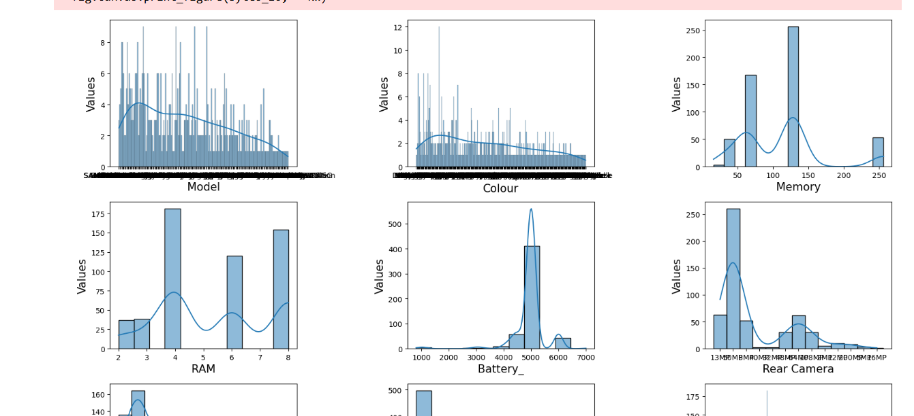
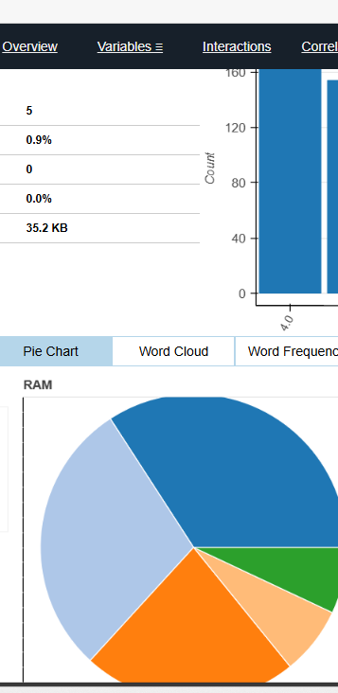
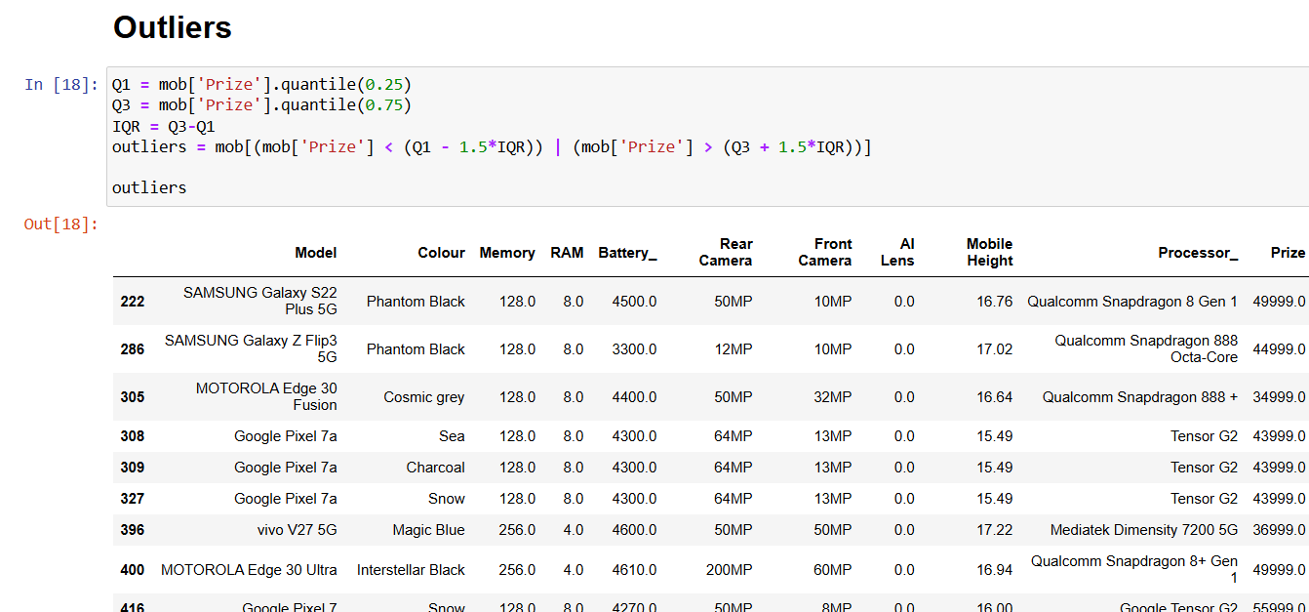
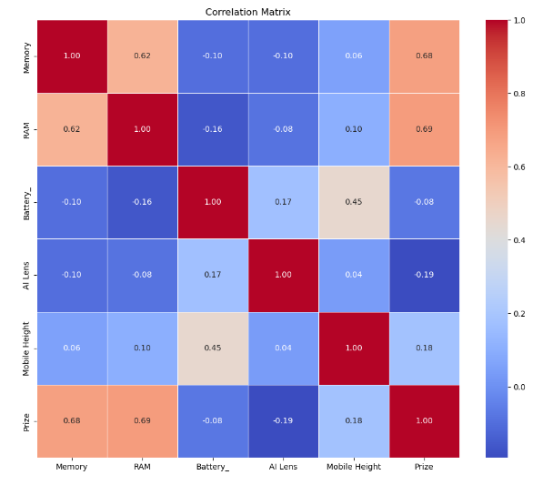
1
2
3
4
5
6
7
8
9
10

Slide 15

Thank you

